Slide 1
Perimeter
& Area
Expressions
Words to
Expressions &
Equations
Inequalities
Equations
100
100
100
100
100
200
200
200
200
200
300
300
300
300
300
400
400
400
400
400
500
500
500
500
500
Team 1
Team 2
Team 3
Team 4
Team 5
Team 6
Team 7
Team 8

Slide 2
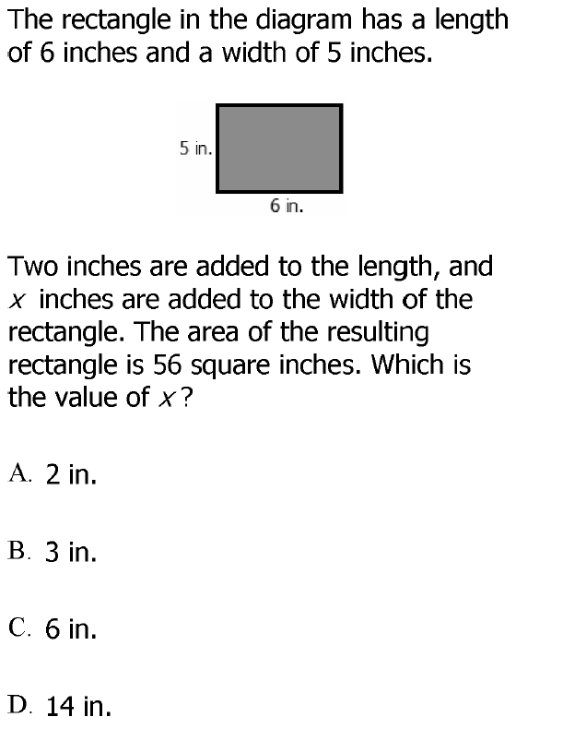
DOK 2

Slide 3
A

Slide 4
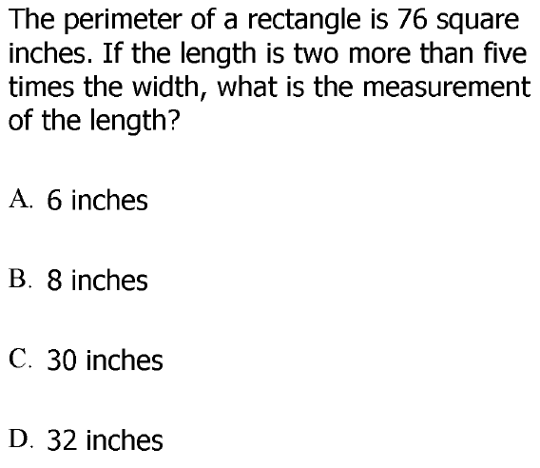
DOK 2

Slide 5
D

Slide 6
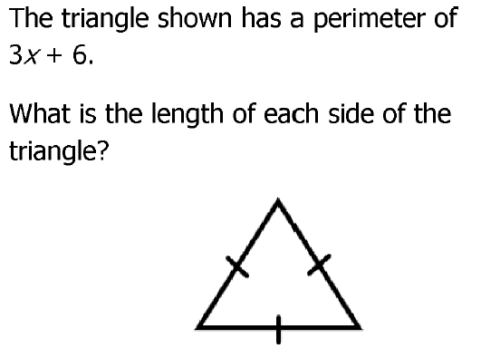
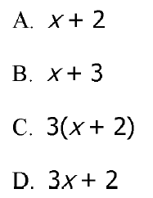
DOK 2

Slide 7
A

Slide 8
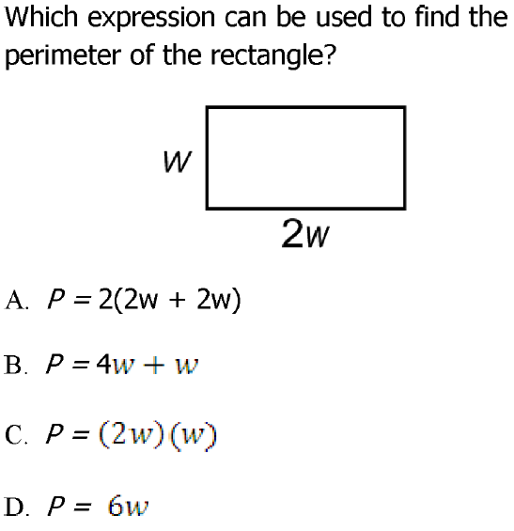
DOK 1

Slide 9
D

Slide 10
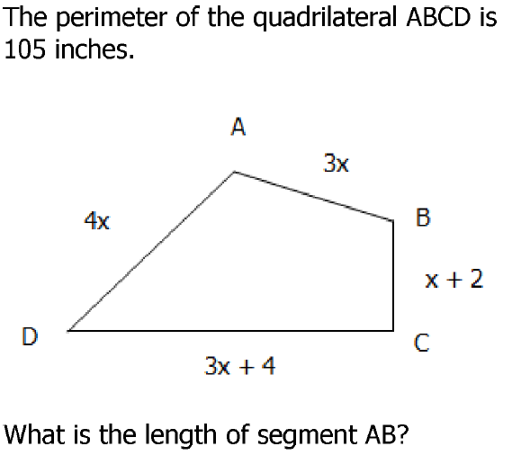
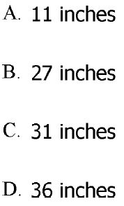
DOK 3

Slide 11
B

Slide 12
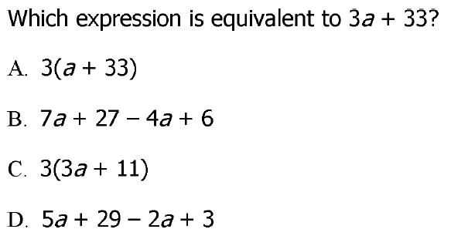
DOK 1

Slide 13
B

Slide 14
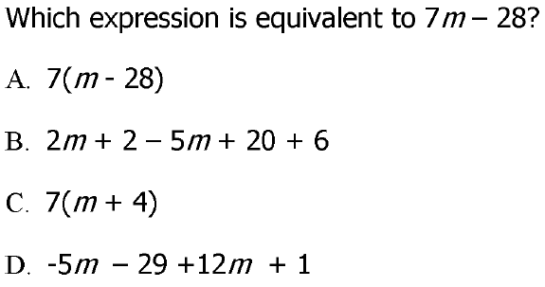
DOK 1

Slide 15
D

Slide 16
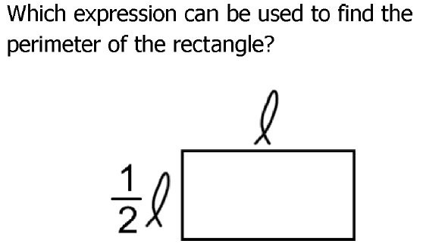
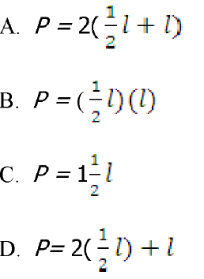
DOK 2

Slide 17
A

Slide 18
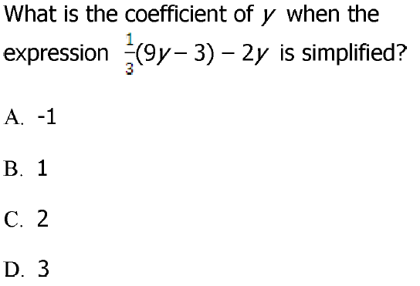
DOK 1

Slide 19
B

Slide 20
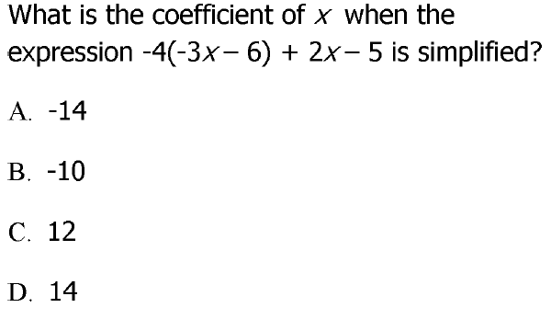
DOK 1

Slide 21
D

Slide 22
DOK 2

Slide 23
A

Slide 24
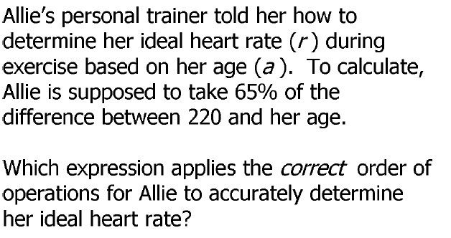
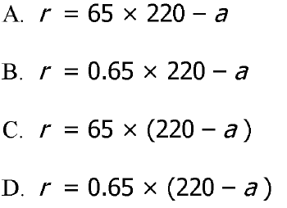
DOK 3

Slide 25
D

Slide 26
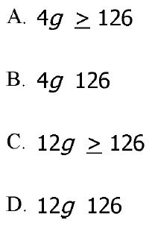
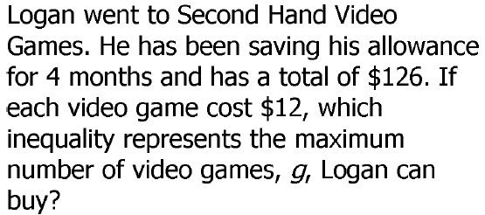
≤
≤
DOK 2

Slide 27
D

Slide 28
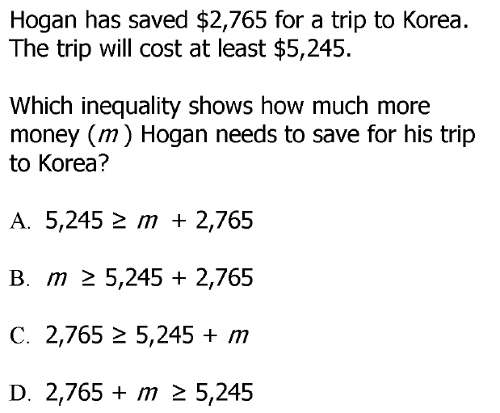
DOK 2

Slide 29
D

Slide 30
DOK 2

Slide 31
B

Slide 32
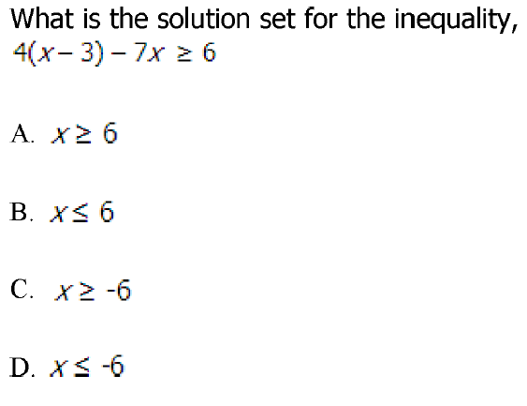
DOK 2

Slide 33
D

Slide 34
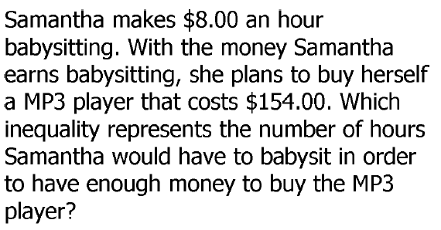
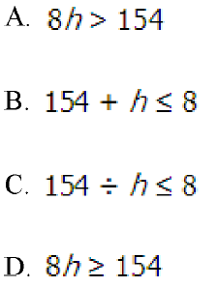
DOK 2

Slide 35
D

Slide 36
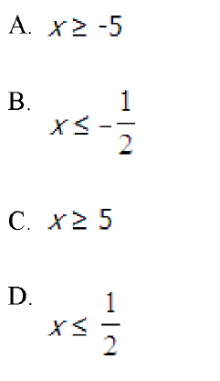
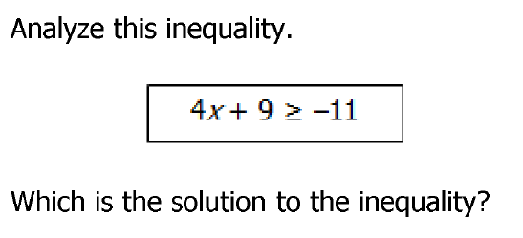
DOK 2

Slide 37
A

Slide 38
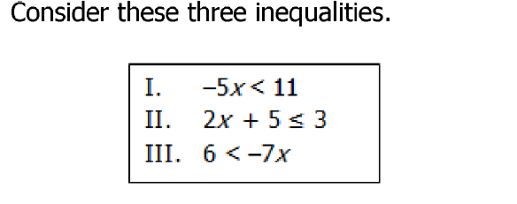
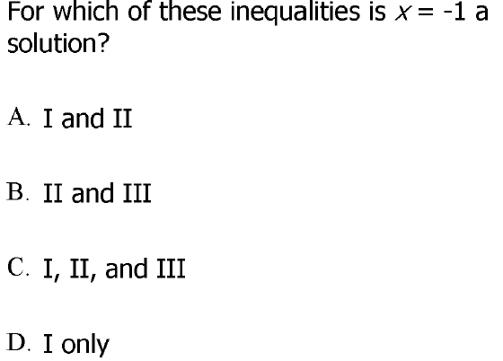
DOK 2

Slide 39
C

Slide 40
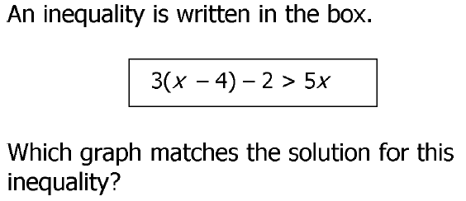
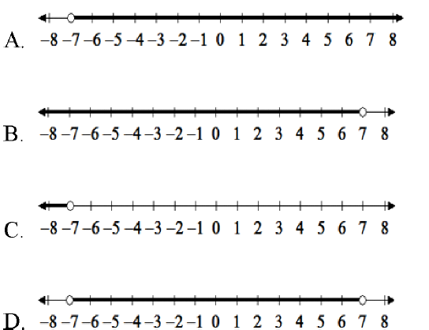
DOK 3

Slide 41
C

Slide 42
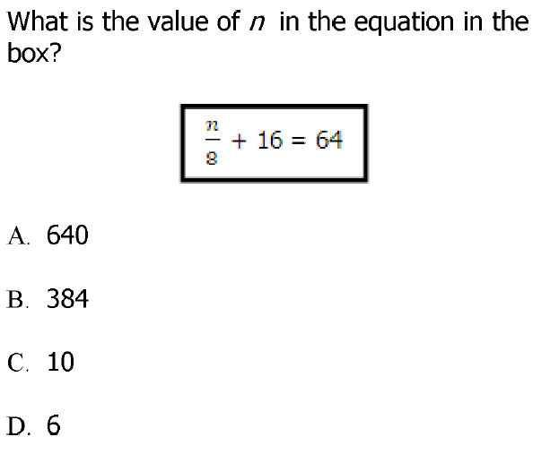
DOK 2

Slide 43
B

Slide 44
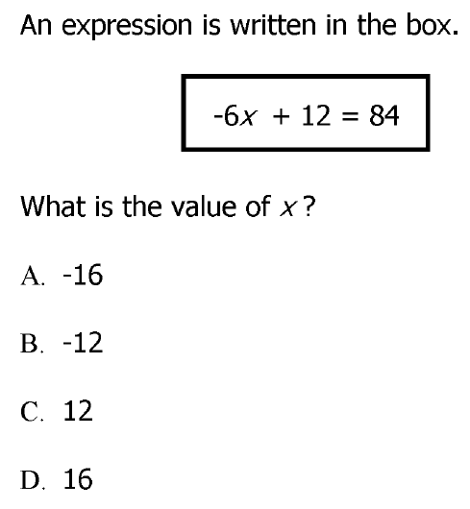
DOK 2

Slide 45
B

Slide 46
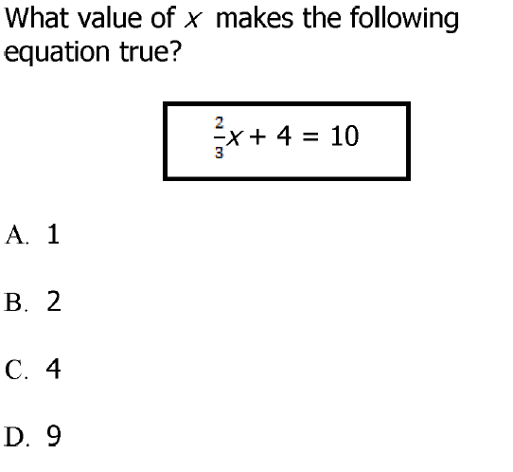
DOK1

Slide 47
D

Slide 48
DOK 2

Slide 49
C

Slide 50
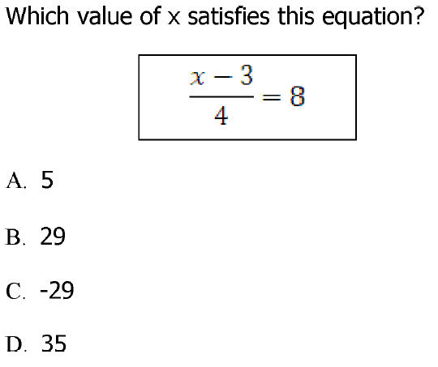
DOK 1

Slide 51
D

